Slide 1
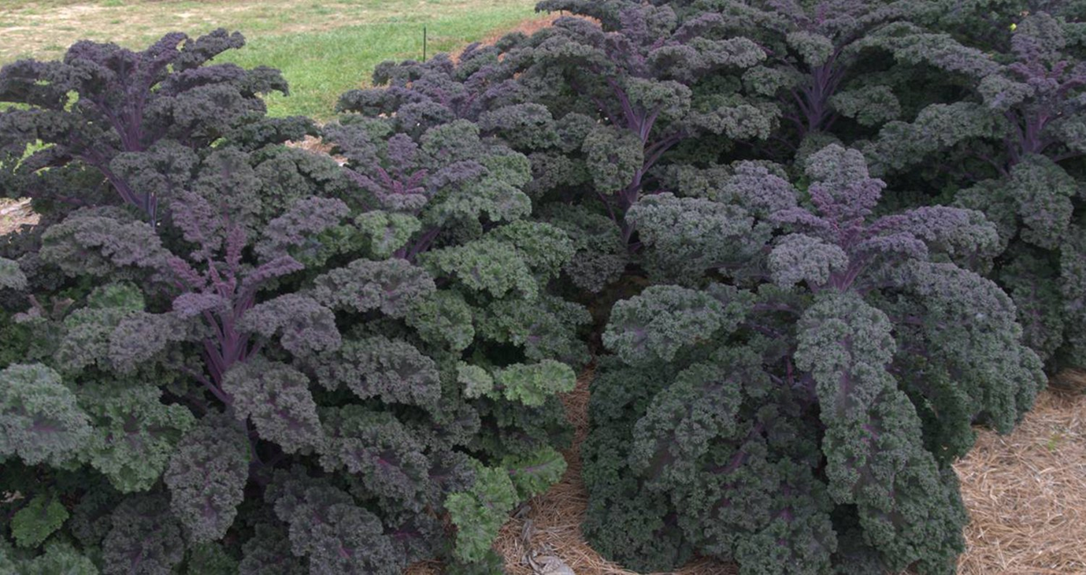

Fall Gardening in the South
Celeste Scott
UT Extension Agent
2021

Slide 2
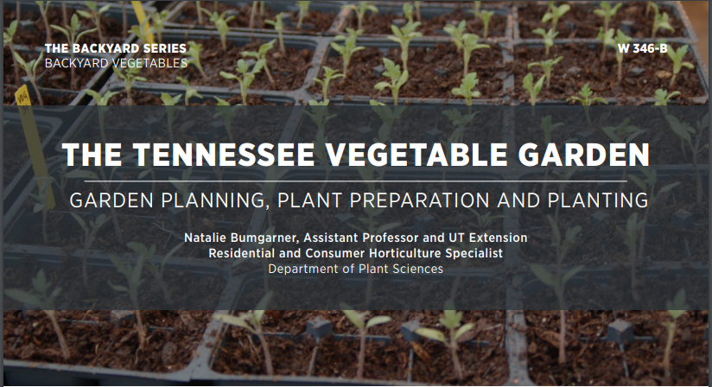
UTHORT.COM

Slide 3
Cool Season Spring Vs. Fall Planting
Spring-planted, cool-season vegetables for summer harvest | Late spring/summer planted warm-season Vegetables | Summer planted, cool-season vegetables for fall harvest
Beets | Beans: Bush, Pole, Lima | Broccoli
Broccoli | Muskmelon | Cabbage
Cabbage | Sweet corn | Cauliflower
Cauliflower | Cucumber | Collards
Carrots | Eggplant | Cucumber
Kale, Collards | Okra | Kale
Kohlrabi | Peas, (field, southern) | Kohlrabi
Lettuce, leaf and head | Pepper, sweet and hot | Lettuce, leaf
Mustard | Pumpkins | Mustard
Onions | Malabar spinach | Potatoes
Peas, English and snap | Squash, summer and winter | Radish
Potatoes, Irish | Sweet potato | Spinach
Radishes | Tomatoes | Squash, summer
Spinach | Watermelon | Tomatoes (determinate)
Swiss chard |  | Turnips
Turnips
Notes:
W346-B
COOL-SEASON VEGETABLES
Can withstand temperatures below 32 F (how far below varies by crop and situation) and are generally more productive and have higher quality produce when grown during cooler spring and fall seasons.
Because of these attributes, cool-season crops are planted in the late winter or early spring to avoid the hottest part of the summer.
They can often be seeded again in the late summer to provide another crop during the fall season.
This is a general guide to think about the timing of planting. Table 5 in W346 B also provides estimates. The earlier dates are used in East TN and the later dates in West TN. More specifics will be provided below.
Often we focus on making sure that our crops are not killed by frost, but it is also important to realize how long crops take to mature. If you seed that sweet corn in late July or early August, you may be quite disappointed.

Slide 4
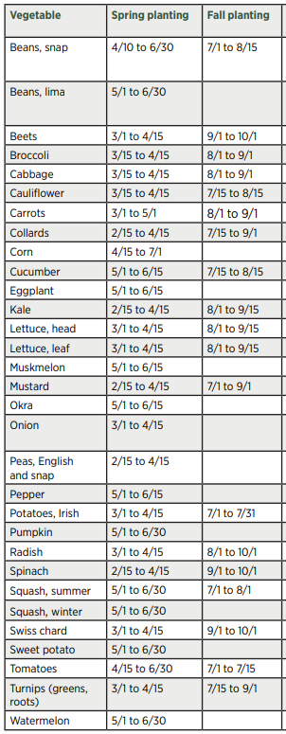
Estimated Planting Dates

Slide 5
Jackson Frost Date Averages
 | Spring 90% | Spring 50% | Spring 10% | Fall 10% | Fall 50% | Fall 90%
32°F | March 25 9 out of 10 yr there WILL be a frost after this date | April 6 | April 19 1 out of 10 yr there WILL be a frost after this date | Oct. 9 1 out of 10 yr there WILL be a frost b/f this date | Oct. 27 | Nov. 13 9 out of 10 yr there WILL be a frost b/f this date
36°F | April 2 9 out of 10 yr there WILL be a frost after this date | April 17 | May 1 1 out of 10 yr there WILL be a frost after this date | Oct. 1 1 out of 10 yr there WILL be a frost b/f this date | Oct. 14 | Oct. 27 9 out of 10 yr there WILL be a frost b/f this date
https://ag.tennessee.edu/climate/Documents/Freeze_Dates_NCDC.pdf
Notes:
First Fall Frost 90% Frost Date
*Only a 10% chance that we will have temperatures lower than 32F BEFORE this date
Jackson Oct 9th
Memphis Oct 30th
Nashville Oct 10th
Mountain City (East TN) Sept. 18th
What does this mean??
90% of the time a frost will occur after the Spring 90% date or 9 out of 10 years. So, this is quite a risky date. On the other hand, a frost will only occur 10% of the time or 1 out of 10 years at the spring 10% date.
IN the fall, 9 out of ten years, there will not be a frost before Oct. 9 (10% date). However, in 9 out of 10 years, there will be a frost before the 90% date.

Slide 6
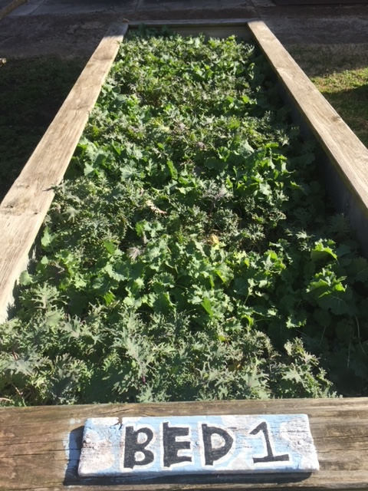
Calculate Planting Dates
1. 90% frost date is October 9th
2. Leaf Lettuce (we will assume it is grown from seed)= 35 Days to Harvest
4. Fall Planting: Count back 4-6 weeks from Oct. 9th
-Planting date range= August 28th- Sept. 11th

Slide 7
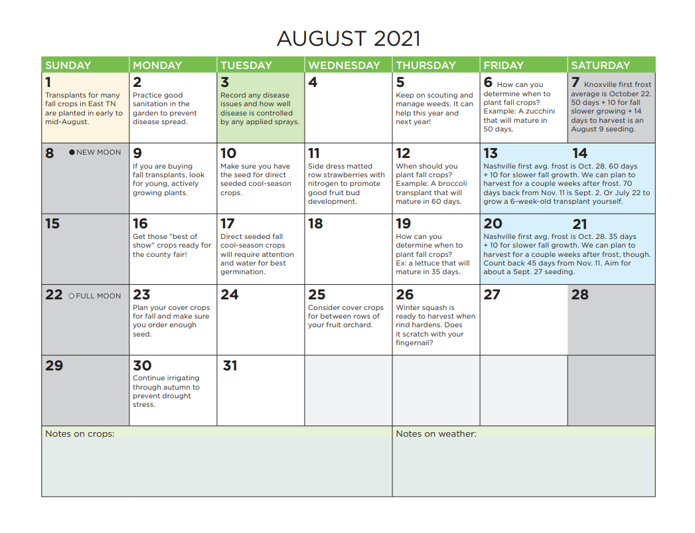
Notes:
Color Codes
Green= ALL
Yellow= East
Blue= Middle
Red= West

Slide 8
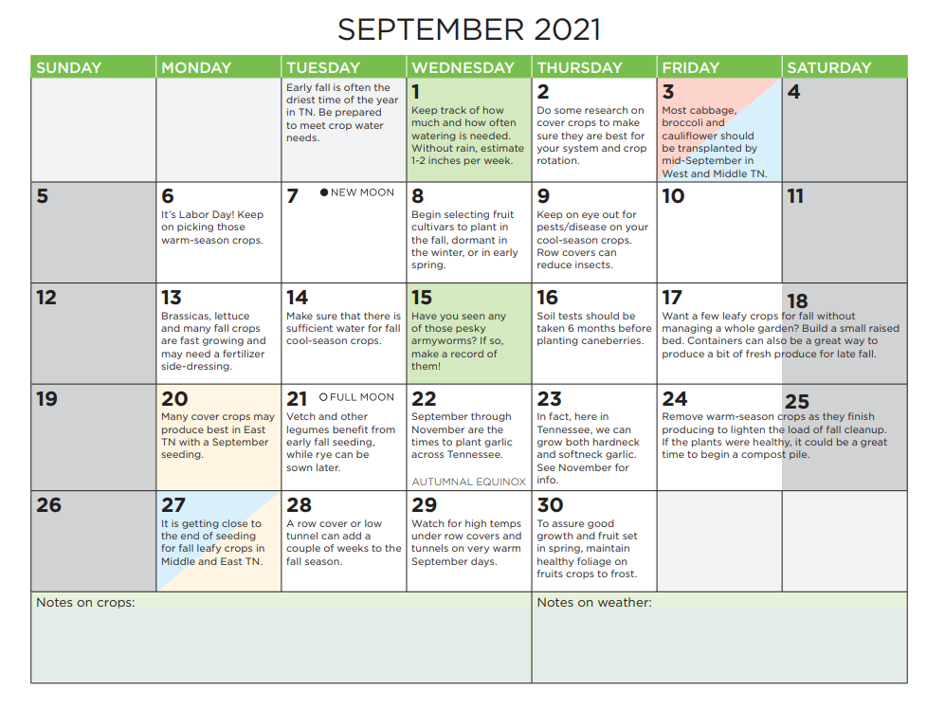

Slide 9
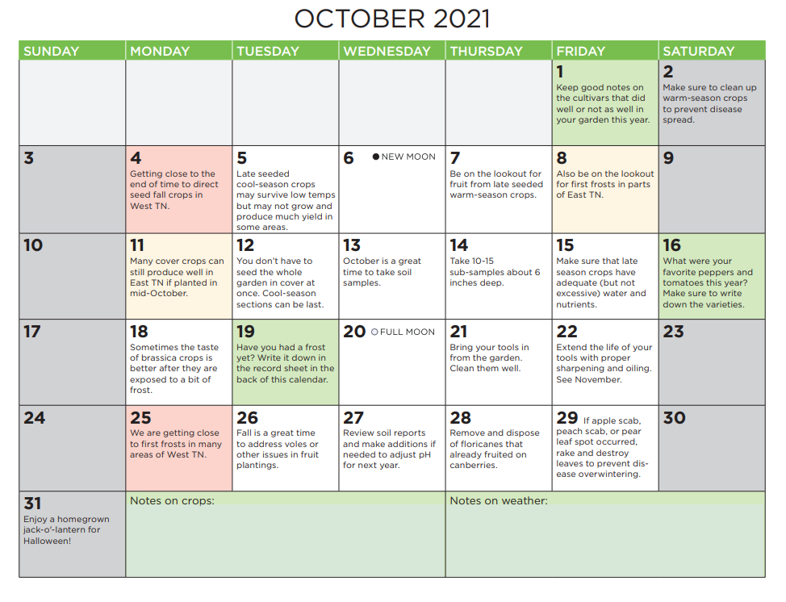

Slide 10
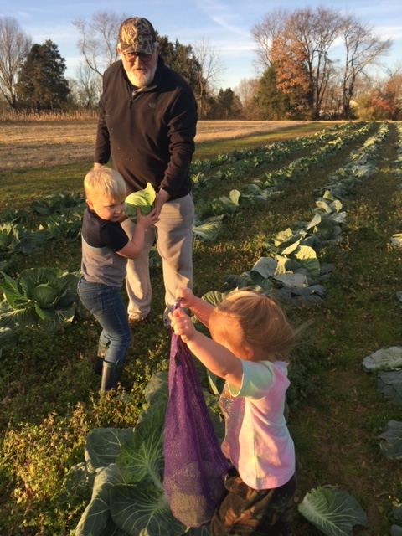
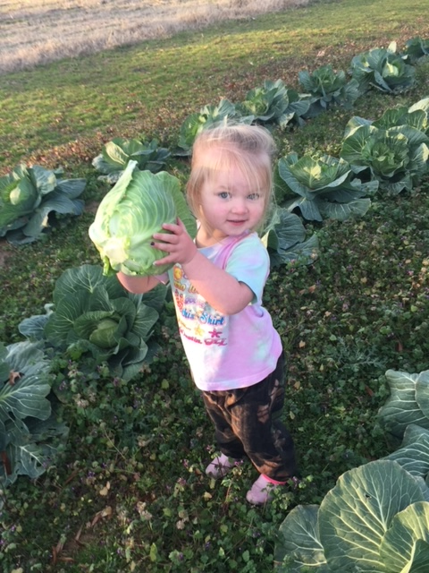

Slide 11
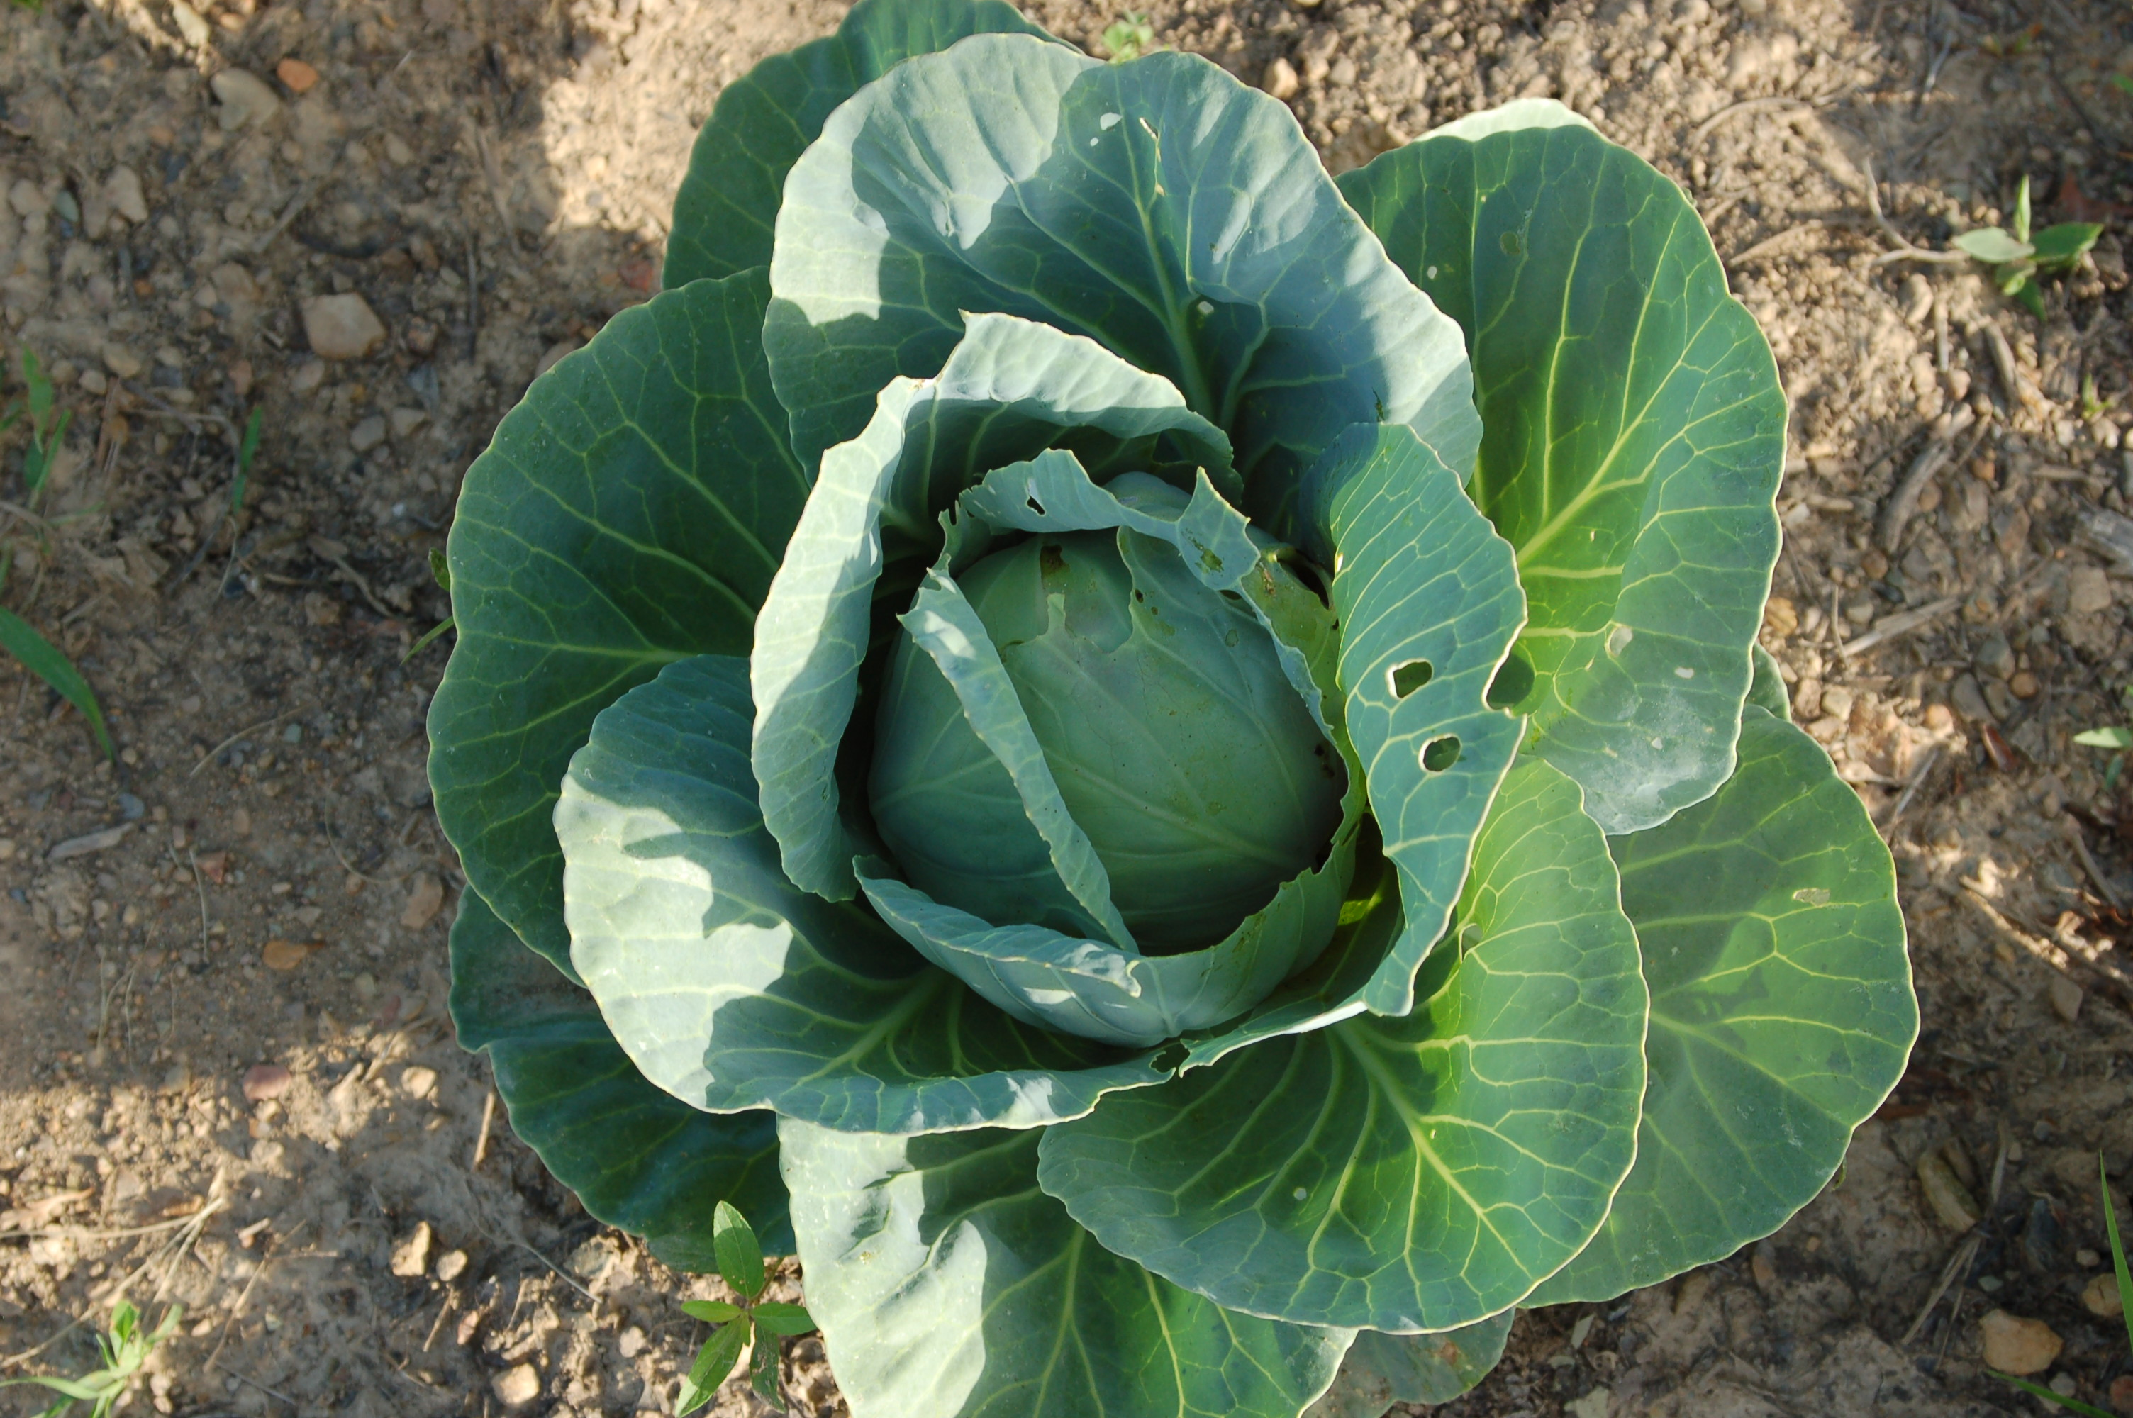
Cool Season Crop Hardiness
Hardy 4-6wk
Moderately Hardy 2 wk
Lettuce
Spinach
Cabbage
Mustard*
Kale*
Peas, snap
Radish, Carrot
Onions
Kohlrabi*
Beets
Broccoli*
Cauliflower
Potatoes (Irish)
Swiss chard
Turnips
Notes:
*Broccoli is LEAST COLD/FROST tolerant
*Mustard, Kale, and Kohlrabi are most cold tolerant and can be overwintered
-Note: Most flowering crops (cauliflower, broccoli) do best as fall plantings due to a lack of ideal temperature for growth 60-65F during spring as well as less disease and insect pressure in the fall.
The most hardy cool season crops can be planted 4 to 6 weeks after the first frost date while moderately cold hardy crops should be planted no later than 2 weeks BEFORE the first frost date.

Slide 12
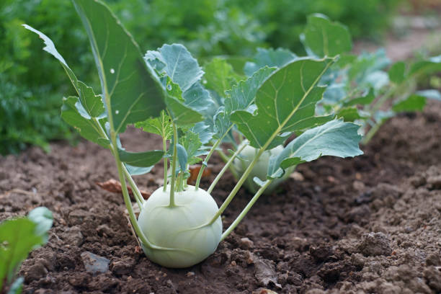
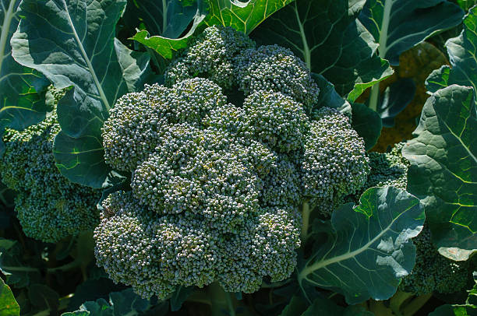
Cole Crops for the TN Vegetable Garden
D59
Stems- Kohlrabi
Immature Flower Head- Broccoli/Cauliflower
Notes:
Gardeners use the term cole crops to refer to several garden plants in the family Brassicaceae
Broccoli, Cauliflower= flowers
Cabbage, Mustard, Collards, Kale, Turnips= Leaves
Kholarabi- Stem
*Brussel sprouts and Cauliflower are very temperature sensitive, if exposed to variations in temperature they tend to bolt without producing their head, Fall planting is more favorable to avoid this condition.
*Most Cold hardy= Kale & Mustard and can overwinter in West TN
*Least Cold hardy= Broccoli

Slide 13
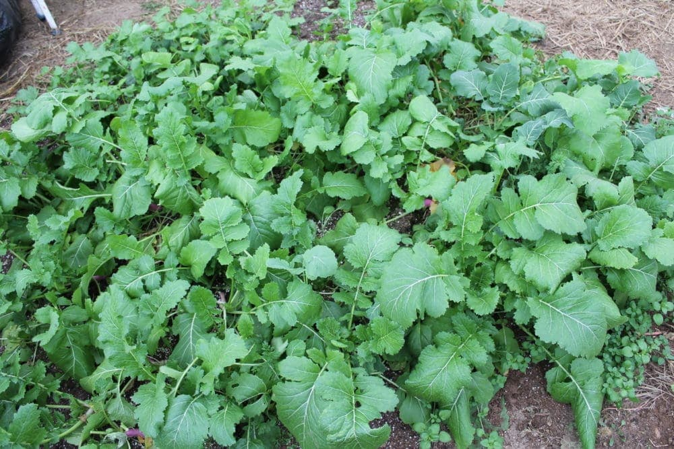

Cole Crops for the TN Vegetable Garden
D59
Greens- Mustard,Turnip, Kale
Notes:
Mustard Greens
Redbor Kale

Slide 14
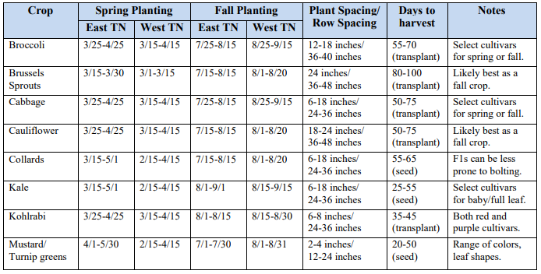

Slide 15
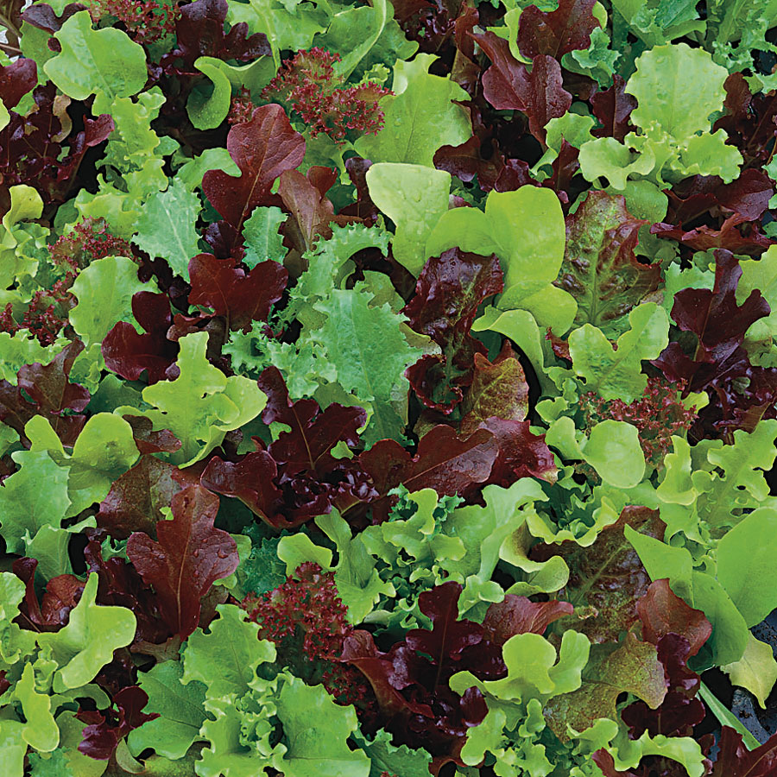
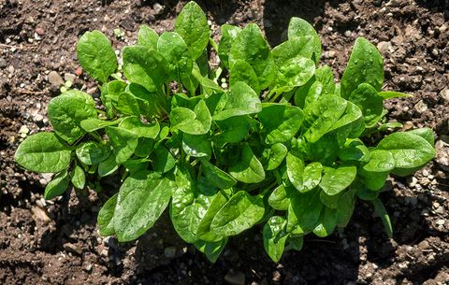
Leafy Crops for the TN Vegetable Garden D68 Lettuce & Spinach
Notes:
Leaf Lettuces relatively cold hardy- work well with season extension
Spinach- The most cold hardy of this group down to 10 F
Arugula- Also cold hardy

Slide 16
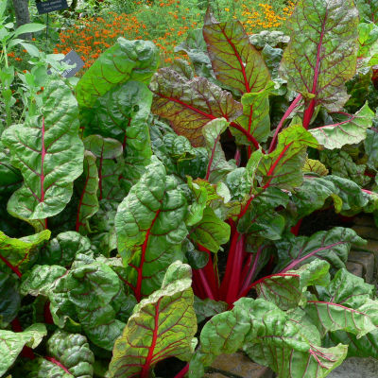
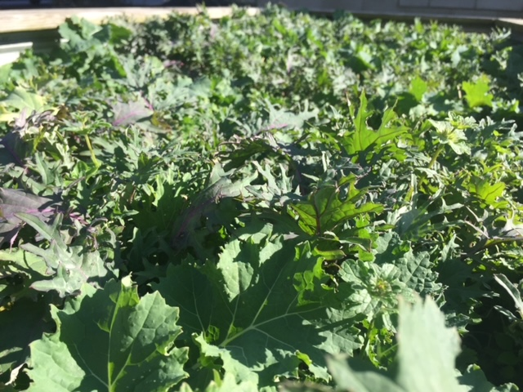
Swiss Chard & Arugula

Slide 17
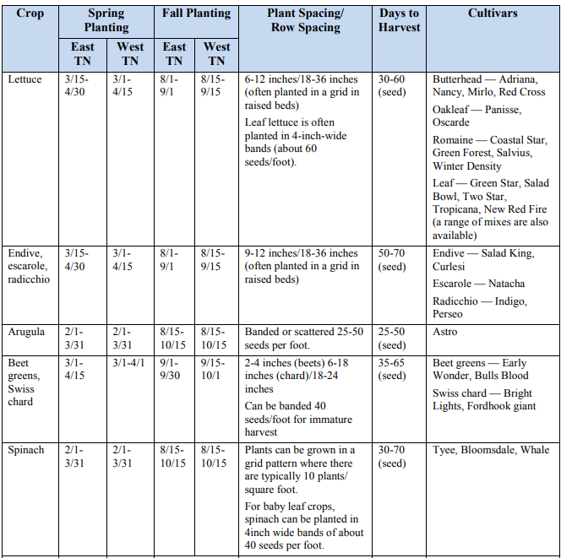

Slide 18
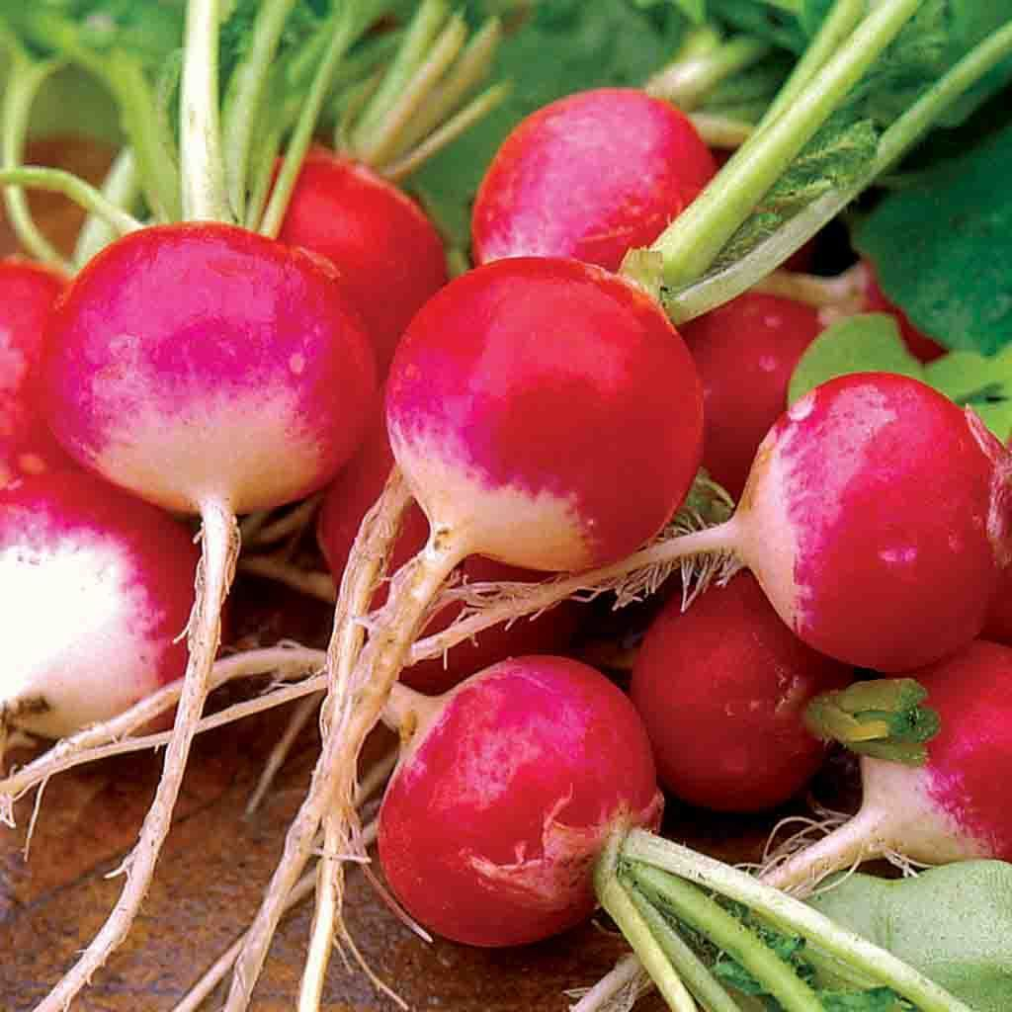
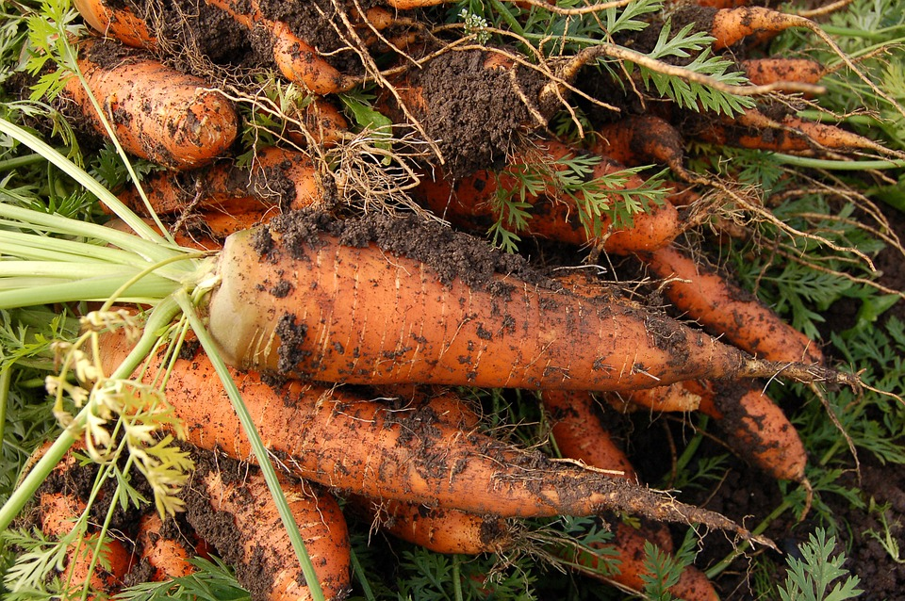
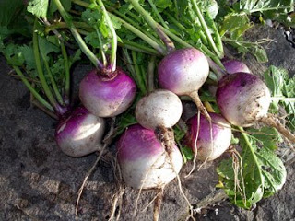
Root Crops for the TN Vegetable Garden D70
Notes:
3 Different Families but with similar growing conditions
Brassicacea- Radish
Apiacea- Carrot
Chenopodiaceae- Beets
*Radish & Turnip can tolerate Clayey soils
*Carrots prefer loss friable soils

Slide 19
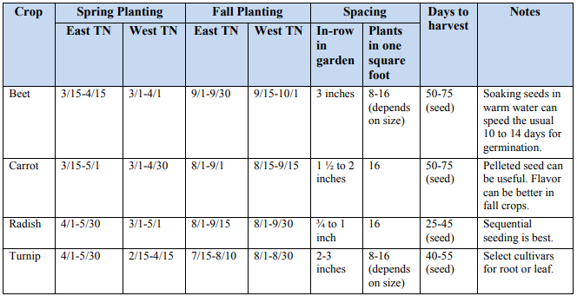

Slide 20
Example Layout
Dual Season 20’x40’
30 ft.
10 ft.
Tomatoes- Mustard/Turnip Greens
Sweet Corn
Cabbage
Eggplant
Ass. Pepper
Squash
Cucumber
20 ft.
Cauliflower/Broccoli
Green Bush Bean
Sweet Corn
Snap Beans
Lettuce, Spinach
Purple Hull Peas
Carrot, Radish
Sweet Potatoes
* For season extension, you could plant cool season plants ahead of warm season and then come back in again with late plantings of cool season after warm season crops play out!

Slide 21
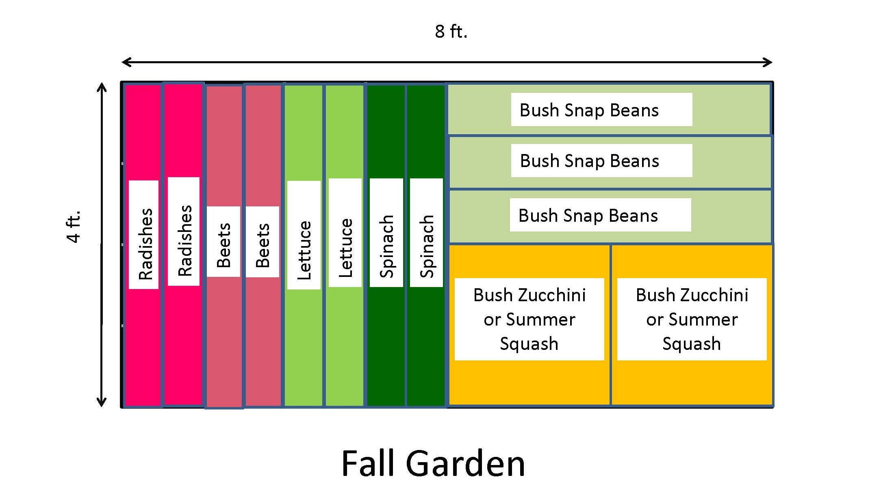
Example Layout
Fall 8’x4’
Notes:
Could be adapted to raised beds and low tunnel or row covers for season extension!

Slide 22
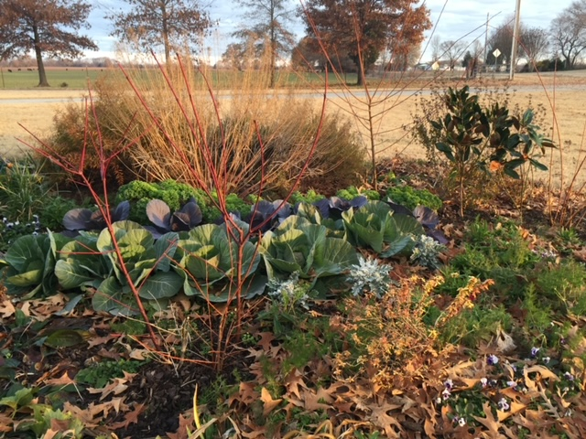
Notes:
Cabbage & Kale in my landscape in Feb.

Slide 23
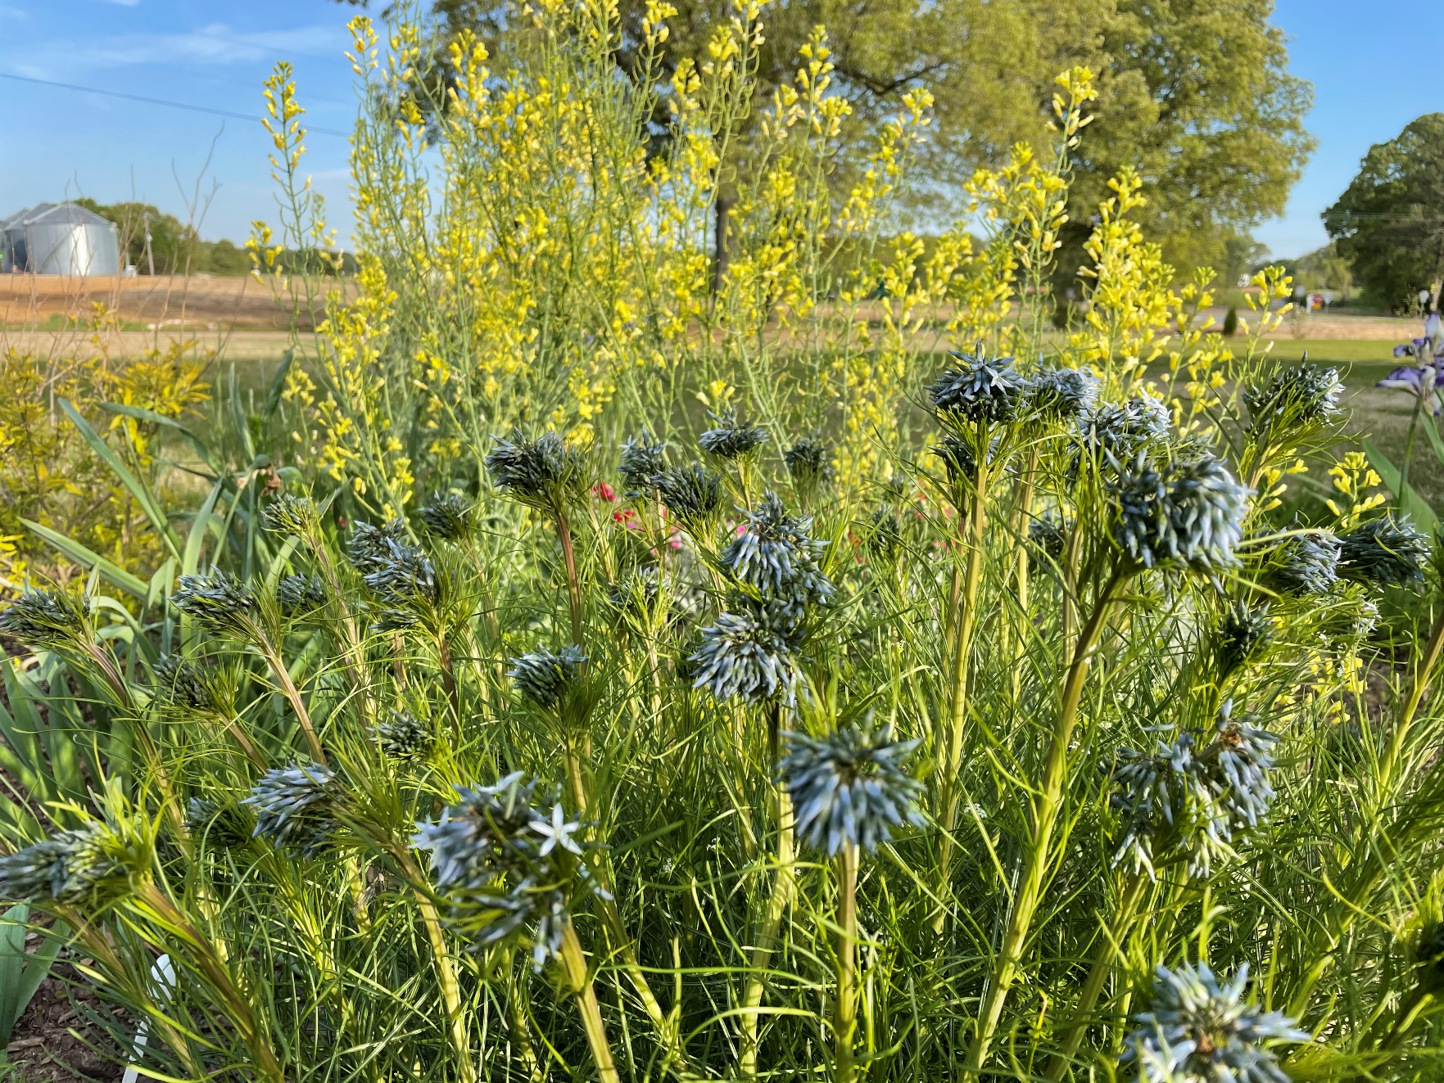
Notes:
Cabbage Flowering in the landscape in early May!

